Slide 1

Moving from I to WE: Integrative, Whole Health Equity (I-WE)
Sue Haddow, MD
Catherine Justice, DPT, C-IAYT, FAIHM
Arti Prasad, MD, FACP, CPDC, CPE
Nneka Sederstrom, PhD

Slide 2
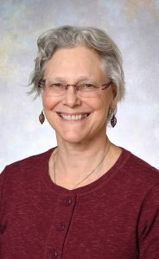
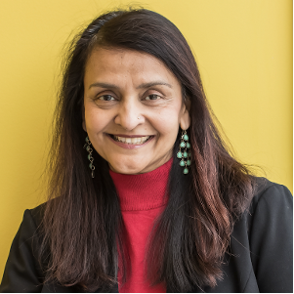
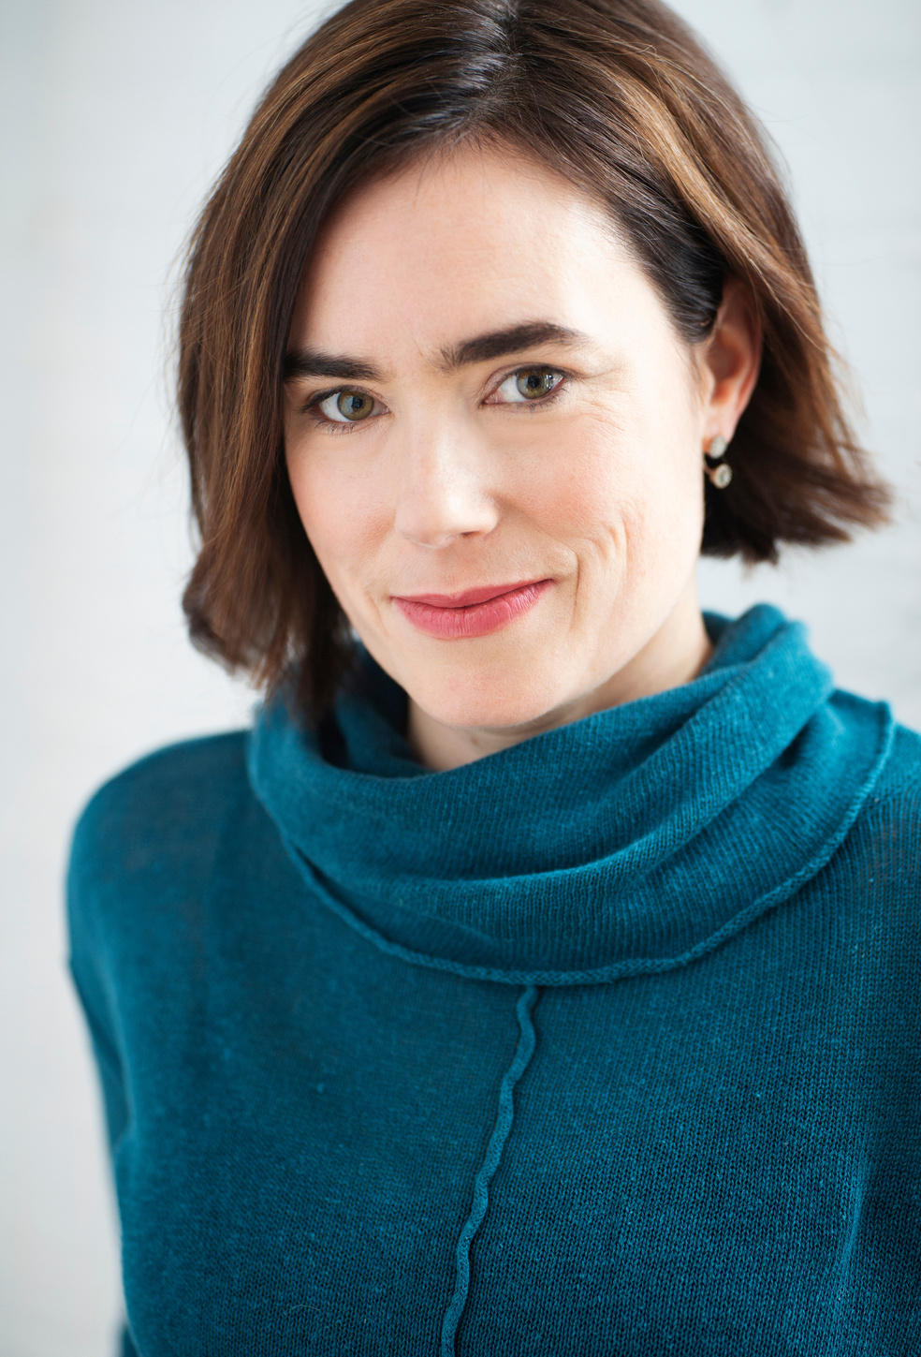
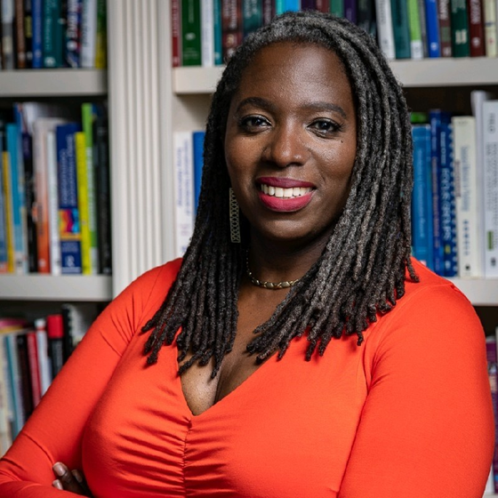
Our
TEAM
Sue Haddow, MD
Arti Prasad, MD
Catherine Justice, DPT
Nneka Sederstrom, PhD
Notes:
Highlight the power of our Chief Equity Officer as a presenter

Slide 3

CENTERING
Notes:
Cat to lead a grounding, breath practice
Someone to talk about why this work is imperative in our current political climate

Slide 4
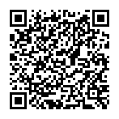
Knowledge Skills and Attitudes Survey (Pre)
Notes:
Cat to lead a grounding, breath practice
Someone to talk about why this work is imperative in our current political climate

Slide 5

OBJECTIVES
3
Dream big and move from “I to WE” - How Integrative health, Whole health, and health Equity partnerships can reshape healthcare and change the world.
2
Explore tangible strategies to leverage IH and HE collaboration within healthcare systems.
From I to WE
1
Explore shared values of Health Equity and Integrative Health within healthcare organizations and systems.

Slide 6
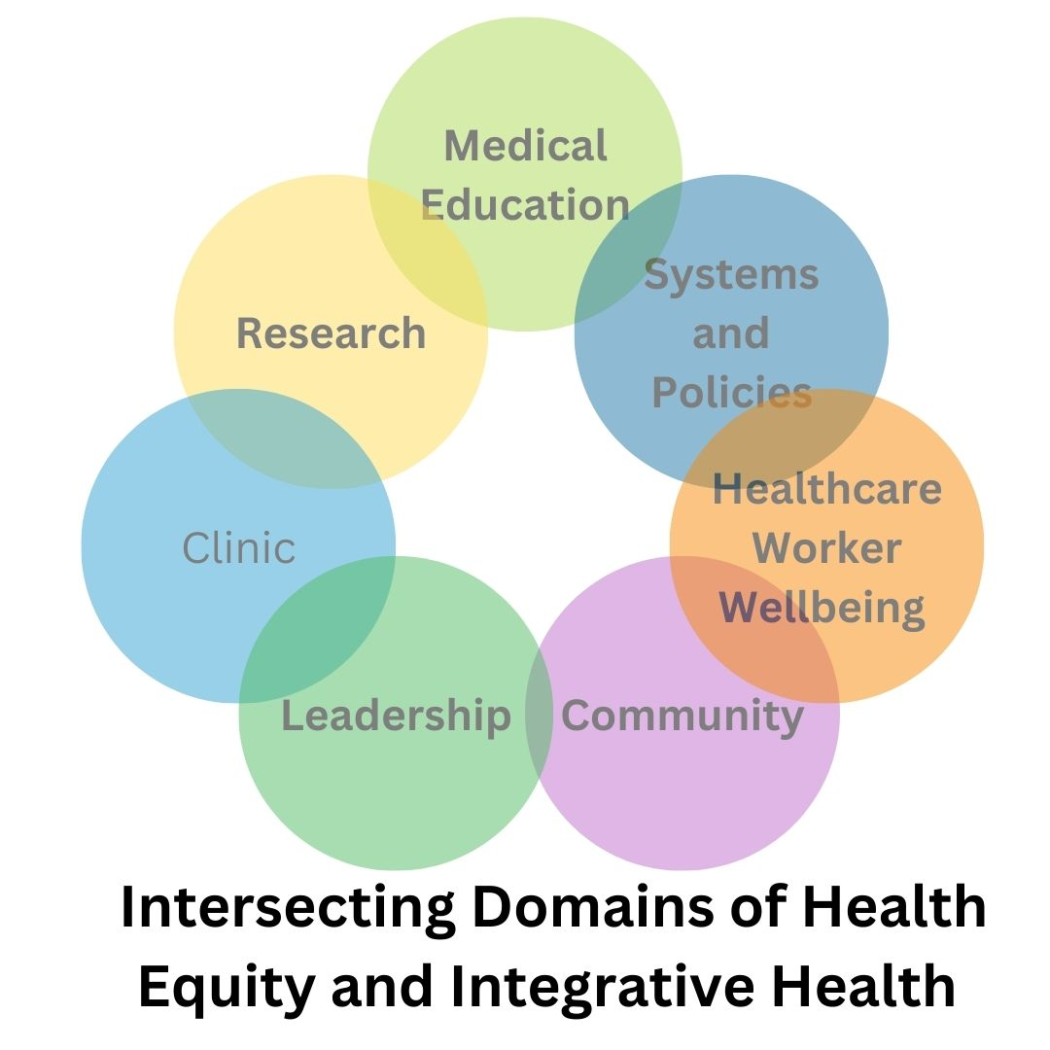
SHARING STORIES
We will share our story and then guide you in experiential activities to create your own
1
Shared Values
2
Tangible Strategies
3
Dreaming Big
Notes:
Human Venn Diagram Exercise:
What of these circles does your work reside within?

Slide 7
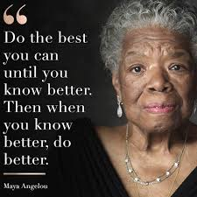
WHO'S IN THE ROOM & GROUP SAFETY
  Take breaks as needed
  Imperfection is assumed
  We are all learners and teachers in this work
  Permission to dream big
  Doubling down on Diversity, Equity, and Inclusion
Notes:
Cat to lead a grounding, breath practice
Someone to talk about why this work is imperative in our current political climate

Slide 8
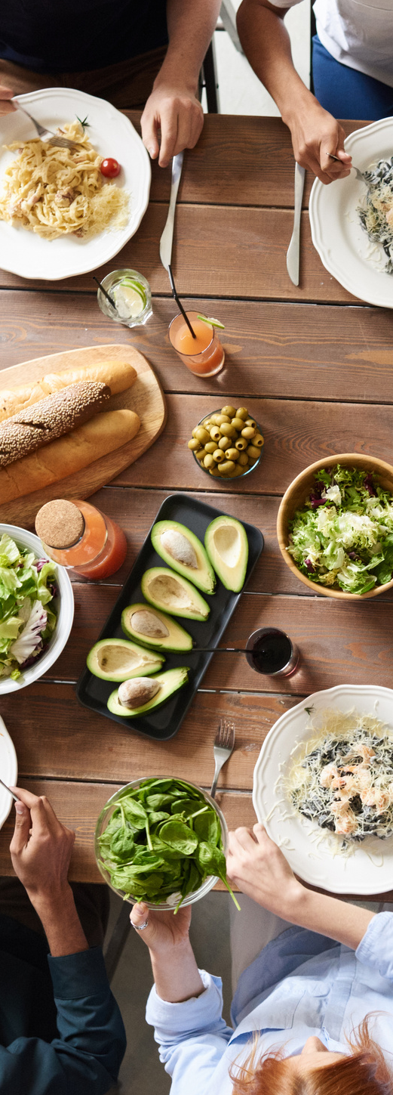

Objective 1
IH and HE Shared Values
INTERVIEW #1
Notes:
When did you first recognize the overlap between IH and HE?
What partnerships arose from there?
Questions from our studio audience?

Slide 9
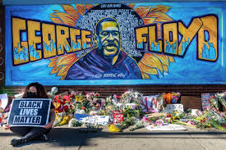
Arti's Experience
Pre George Floyd incident:
Establishing the Office of Equity and Social Justice
Health Symposium on Trauma, Race, Inclusion, Diversity,
and Equity (STRIDE)
COVID shut down starts a week before the conference
George Floyd incident happens on May 25, 2020
Nneka's Experience:
"My daddy changed the world!"
Leads to the hiring of Dr. Sederstrom, the Chief Health Equity Officer.
Development of Health Equity department and growth under Dr. Sederstrom's leadership

Slide 10
EXPERIENTIAL
1
Shared Values
2
Tangible Strategies
3
Dreaming Big
Notes:
Human Venn Diagram Exercise:
What of these circles does your work reside within?

Slide 11

Group Discussion
WORD CLOUD
  Authenticity
  Adventure
  Authority
  Autonomy
  Balance
  Beauty
  Belonging
  Boldness
  Compassion
  Challenge
  Citizenship
  Community
  Contribution
  Creativity
  Culture
  Curiosity
  Determination
  Diversity
  Equity/ Fairness
  Faith
  Friendships
  Fun
  Growth
  Happiness
  Honesty
  Humor
  Inclusion
  Inner Harmony
  Justice
  Kindness
  Knowledge
  Leadership
  Learning
  Love
  Loyalty
  Meaningful Work
  Openness
  Optimism
  Peace
  Pleasure
  Popularity
  Recognition
  Relationships
  Reputation
  Resilience
  Respect
  Responsibility
  Security
  Self-Respect
  Service
  Social Justice
  Spirituality
  Stability
  Stewardship
  Success
  Trustworthiness
  Wellness
  Wholistic
  Wisdom

Slide 12

Small Group Discussion #1
  Shared Values
  If you had the opportunity to have an airplane conversation about the intersection of IH and HE with your leadership, what would you talk about?
  Pick one domain and brainstorm how these shared IH & HE values play out
  Find a way to recap your discussion with the larger group, creativity is encouraged (pictures, bullet point lists, narrative, haiku, etc.)!

Slide 13




Objective 2: Tangible Strategies
IH and HE Programming
INTERVIEW #2
Notes:
Interview Nneka on this topic
How did COMPASS come to be? How did it get implemented? Participant feedback.
Breaking down the first wall
Creating a pathway to doing things better
Seeing White Podcast: Black and Native experiences
Emotional/physical reactions reflection
Addressing the barriers that arise in your head as you hear/ talk about this information.
Highlight our overall program – BIGGEST IN THE COUNTRY!!!!
Interview Dr Prasad on this topic
Our Project ECHO advocacy and partnership and/or TIE EL Program and/or Heals on Wheels and/or Talent Garden
Questions from our studio audience?

Slide 14
IH and HE Programming
Seeing White Podcast, Large Group Discussion
Notes:
Nneka comes back and talks more about COMPASS

Slide 15
EXPERIENTIAL
1
Shared Values
2
Tangible Strategies
3
Dreaming Big
Notes:
Human Venn Diagram Exercise:
What of these circles does your work reside within?

Slide 16

Group Discussion #2
Seeing White Podcast
  Reflection: As you listen, what do you notice about any physical, mental, and/or emotional reactions happening inside of you?
  How does this relate to your work in IH?
Notes:
Un-Conference

Slide 17
Small Group Discussion #2
Tangible Strategies
  Come up with tangible ideas for one or more of these domains​ and write them on your worksheet
  Examples: Research/grant specific aims or goals/objectives​, a program description for community or HCW wellbeing, talking points for a legislative testimony, etc.
  Be prepared to share your ideas with the larger group
Notes:
No one person is an expert – three people leading (clinic, education, research)

Slide 18


Objective 3
I to WE
Dreaming Big
INTERVIEW #3
Notes:
Institute for Whole Health Equity – our dreams for it – infusing our health system with these values

Slide 19

Group Discussion #3
Google Images
  Where can you visualize the impact of Health Equity and Integrative Health collaborations? What is the change you would see in the world if this happened? What would be possible if you had no barriers or limits?
Notes:
Un-Conference

Slide 20
VISION BOARD
Notes:
Un-Conference

Slide 21
EXPERIENTIAL
1
Shared Values
2
Tangible Strategies
3
Dreaming Big
Notes:
Human Venn Diagram Exercise:
What of these circles does your work reside within?

Slide 22
Small Group Discussion #3
Dreaming Big
  Drafting a memo to policy stakeholders
Notes:
No one person is an expert – three people leading (clinic, education, research)

Slide 23
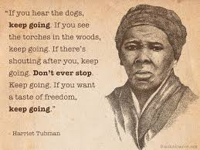
Notes:
Nneka – Keep Going

Slide 24
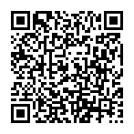
Knowledge Skills and Attitudes Survey (Post)
Notes:
Cat to lead a grounding, breath practice
Someone to talk about why this work is imperative in our current political climate

Slide 25

CHECK OUT & CLOSING
  Write a postcard to yourself to remind yourself how to carry this work forward
  Share postcards
  One word check-out
Notes:
Reiterate why this work is imperative in our current political climate - Double down on DEI!!!!
If you want, exchange a postcard with a friend :)

Slide 26


CONTACTS
catherine.justice@hcmed.org
arti.prasad@hcmed.org
susan.haddow@hcmed.org
  nneka.sederstrom@hcmed.org

